Slide 1
Successful Web searches!
Notes:
Successful Web Searches PPT #T56 provides an introduction to using Google in particular, and search engines in general, to achieve better results for your academic research.
RESOURCES
The world of information (Beyond Google) https://www.youtube.com/watch?v=IkWadth56zs
This visualizes the different resources on the Internet not covered by search engines such as Google. Video is 2:42 min. (Resource #F305 in the HCT Student Research website)
#T60 Successful Searching with Google WORKSHEET
#F303 Internet Searching tips Tutorial http://www.wou.edu/provost/library/clip/tutorials/internet_tips.htm A clear explanation of how search engines like Google work – what they do with your query, and how to design a better search to get good results. Produced by CLIP, US. Tutorial is 4:05 min.
#F304 Searching with Success Tutorial http://library.acadiau.ca/tutorials/websearching/ This quick tutorial introduces students to different resources they will find on the Web, including the surface and deep web, and tips for how to search more effectively. Produced by Vaughan Memorial Library, Canada. Tutorial takes approx. 10 min.
#F302 HCT One Minute Guides: Google Advanced Search https://www.youtube.com/watch?v=3G9kLPtOVKc from the HCT Student Research website
All search engines, including Google, have an “advanced search” ability to get far better results – demonstrated on this short video. Video is 0:55 min.
#F306 Using Google Scholar https://www.youtube.com/watch?v=t1ZwgDeX2eQ
A clear and useful introduction to searching in Google Scholar. Produced by Cooperative Library Instruction Project (CLIP), US. Video is 7:02 min.
NOTE
To understand the different web resources you might find on the Internet and how to evaluate and select appropriate academic information, review #T103 PPT Evaluating Information Resources from the HCT Student Research website

Slide 2
If you type your keywords into Google, you’ll get millions of hits! Is that useful?
Notes:
Is millions of hits useful? No
Put your hand up if you usually look at the second page of results?
Keep your hand up if you usually look at the third page of results? The fourth page?
For most people, finding 30-40 good results would be loads of information!
The goal is to make your results list much more focused on the academic information you need, rather than finding millions of useless hits. Let’s not waste time ☺

Slide 3
Notes:
There are many search engines in the Internet, though Google is by far the biggest. They do cover different parts of the Internet however – no ONE search engine covers it all, so try another if you get no results.
BTW, why do you think that search engines exist at all?
They are there to MAKE MONEY. Pure and simple. Don’t forget that when you’re looking through your results list, as money often has an influence over where results appear!

Slide 4
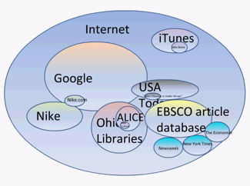
Notes:
The other thing to keep in mind is that there is a lot of information on the Internet which search engines like Google do not have access to. This is sometimes referred to as the surface and the deep web – search engines have access to the surface web only.
Review this short VIDEO The world of information (Beyond Google) https://www.youtube.com/watch?v=IkWadth56zs Video is hyperlinked to this slide image.
This visualizes the different resources on the Internet not covered by search engines such as Google. Video is 2:42 min. (Resource #F305 in the HCT Student Research website)

Slide 5
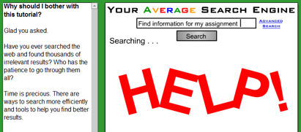
WATCH this short VIDEO: Internet Searching Tips Tutorial (4:05 min.)
Now try this TUTORIAL: Searching with Success (10 min.)
Notes:
#F303 Internet Searching tips Tutorial http://www.wou.edu/provost/library/clip/tutorials/internet_tips.htm A clear explanation of how search engines like Google work – what they do with your query, and how to design a better search to get good results. Produced by CLIP, US. Tutorial is 4:05 min.
NOTE This tutorial is hyperlinked to the top image.
If time, also try this excellent resource. Otherwise this tutorial could be suggested before or after class time.
#F304 Searching with Success Tutorial http://library.acadiau.ca/tutorials/websearching/ This quick tutorial introduces students to different resources they will find on the Web, including the surface and deep web, and tips for how to search more effectively. Produced by Vaughan Memorial Library, Canada. Tutorial takes approx. 10 min.
NOTE This tutorial is hyperlinked to the bottom image.

Slide 6
Notes:
Assuming that everyone uses Google a lot to find the information they need, let’s make the most of your search time ☺
#T60 Successful Searching with Google WORKSHEET – students complete the first half of the worksheet using the normal Google search bar (as in this slide)
WATCH #F302 HCT One Minute Guides: Google Advanced Search https://www.youtube.com/watch?v=3G9kLPtOVKc from the HCT Student Research website Video is 0:55 min. All search engines, including Google, have an “advanced search” ability to get far better results – demonstrated on this short video.
#T60 Successful Searching with Google WORKSHEET – students now complete the rest of this worksheet by experimenting with advanced search options.

Slide 7
Now, introducing …
https://scholar.google.ae/
Notes:
Let’s really get into academic searching ☺

Slide 8
Good for … Covering more journals than our library databases - Able to include our library links in the results May lead to free online articles Includes links for finding related articles and citations Better for conference proceedings, dissertations, repositories, websites

Slide 9
Not so good … Limited full-text options – results often lead to publisher sites requesting payment for articles Uneven coverage of disciplines (some better than others) Indexing time lag – more recent resources sometimes missing

Slide 10
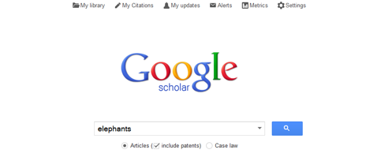
https://scholar.google.ae/
Let’s have a quick look!
Notes:
WATCH #F306 Using Google Scholar https://www.youtube.com/watch?v=t1ZwgDeX2eQ
A clear and useful introduction to searching in Google Scholar. Produced by Cooperative Library Instruction Project (CLIP), US. Video is 7:02 min.

Slide 11
Start by creating an account (with Gmail) using the “My Library” tab
Notes:
Time to try out using Google Scholar

Slide 12
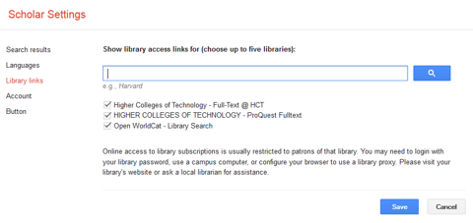
Go into “Settings” tab
Add HCT libraries, if not already showing
Notes:
USE “Library Links” in Scholar Settings, and search for HCT. If HCT is already there and ticked, Scholar will link to HCT resources in the results list for your searches automatically.
When following a link to HCT resources, you may be asked for user name and password.

Slide 13
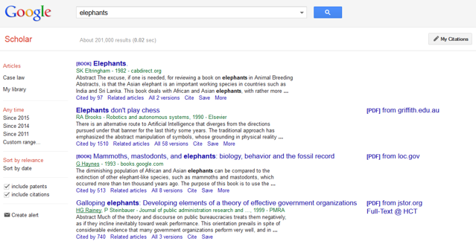
Narrow your search results by options in this panel…
… or expand your search by clicking “Related articles”

Slide 14
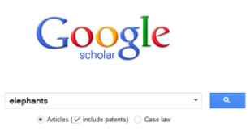
Advanced search options are also available to focus your results (click the arrow)

Slide 15
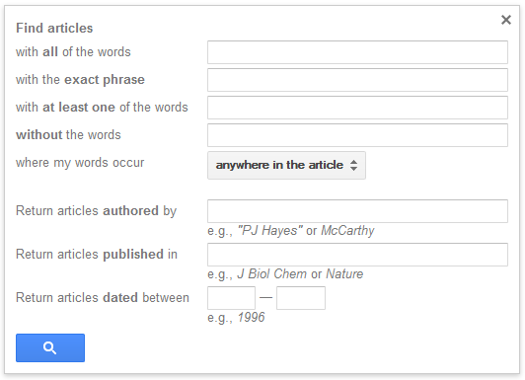
Advanced search options are similar to those in basic Google

Slide 16
Full-text articles are flagged as PDF or HTML here
HCT full-text articles are flagged here too
Click these links to retrieve the articles
Notes:
Ask students: What is the difference between a PDF and HTML copy of an article?
ANSWERS:
PDF is like a photocopy of the pages of the article as it appeared in the journal – includes pictures, graphs, statistics, page numbers
HTML often just shows the words which were in the article. Sometimes images and other things are shown, but not always. Page numbers are important for the citation of the journal article, as you will know/find out when looking at citations and referencing

Slide 17
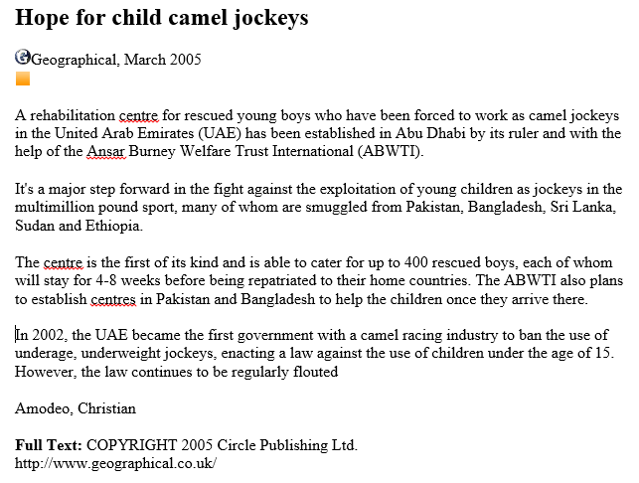
Before you start
What do I already know about the topic?
What do I need to find out?
Notes:
Example
This is a HTML copy of an article titled “Hope for child camel jockeys”, from the journal Geographical, March, 2005.

Slide 18
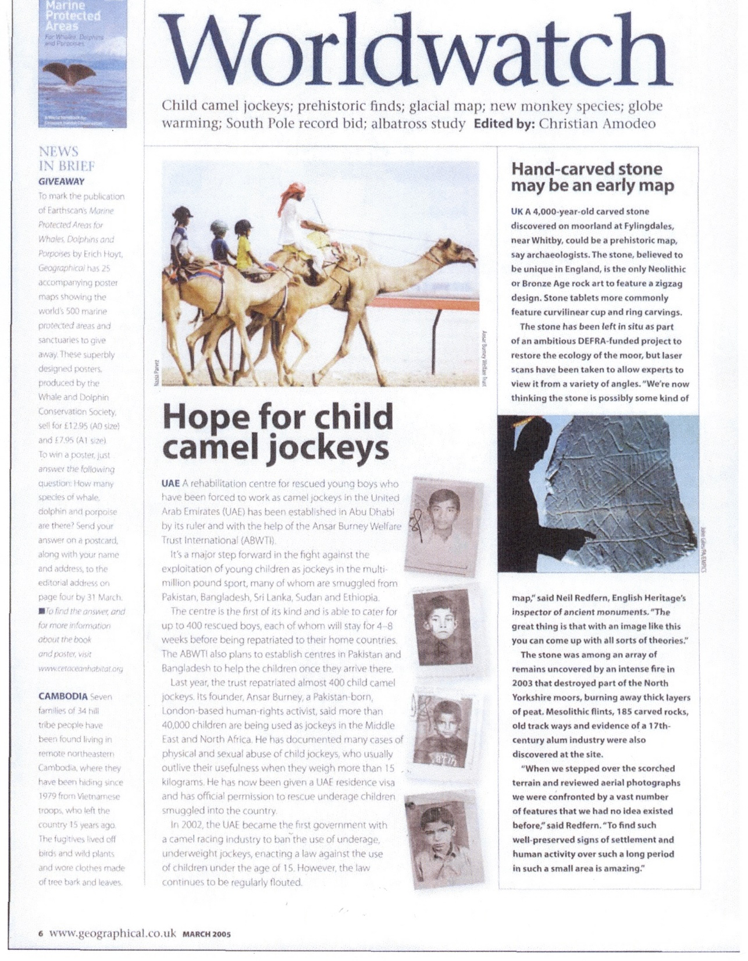
This is a PDF copy of the same article titled “Hope for child camel jockeys”, from the journal Geographical, March, 2005.
Page 6.
Notes:
Comments?
Easier to read?
Images and layout of text?
Page number included – V. Important for the APA citation of this resource

Slide 19
Click the “Cite” option if you would like to see the full citation for this resource, in either
MLA, APA or Chicago style

Slide 20
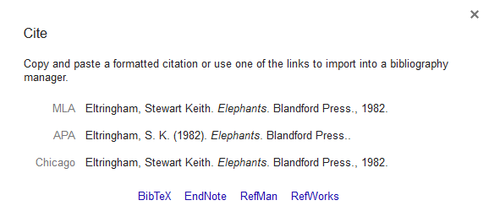
This pop-up screen appears if you have clicked on the “Cite” option

