Slide 1
Starting your Research
Notes:
For this lesson, we will introduce students to THE RESEARCH PROCESS – how to pull together good quality assignments required in higher education by following a simple path ☺
NOTE that this session could be split into 2 sessions, based on the 3 different parts of the research process:
INTRODUCTION and STEP 1: Know exactly what you are asked to do, and keywords etc. (slides 1-22)
STEP 2: Where might I find the information? And STEP 3: Finding the information (slides 23-end)
The section on Finding the Information for this session has been limited to using the HCT library catalog (also dealt with separately in #T55 in the HCT Student Research website). Understanding what they are, and finding other information resources are dealt with in separate lesson plans, such as “Articles and Databases” (#T50), or “eBooks” (#T54), or (#T56) “Successful Web Searches” in the HCT Student Research website.
RESOURCES:
Starting your Research PPT (#T13 in HCT Student Research website)
Background Information” #T10 “Big6 The Research Process: Teacher Introduction”
Web link to the Big6 research model: http://dwc.hct.ac.ae/lrc/ifooz/artwork/ Undertaking this excellent interactive tutorial could be done out of class time - discussed slides 14-15 (#U200 in HCT Student Research website)
WORKSHEET “Planning my Research Project” (#T11 in HCT Student Research website)
WORKSHEET “Synonyms/ broader and narrower words” (#T52 in HCT Student Research website)
VIDEO: “Generating Search Terms” to reinforce these ideas. https://www.youtube.com/watch?v=lBcHuWnDUQ0 (#F13 in the HCT Student Research website)
Optional prizes for Slide 22 activity

Slide 2
http://libraries.hct.ac.ae/

Slide 3
Let’s look at …
What is Research?...
How to start your research
The library catalogue – finding resources

Slide 4
What is Research?
Notes:
Not just experimental science!

Slide 5
Britannica Online
1. Careful study and investigation for the purpose of discovering and explaining new knowledge.
2.The collecting of information about a subject

Slide 6
Notes:
No need to panic ☺

Slide 7
Beginning Research
People often feel anxious at the start.
… and this is normal.
You will go through many emotions …
The key is to PLAN!
Notes:
… if you want to do well ☺

Slide 8
Beginning Research
Key is to PLAN
Give yourself TIME
Be PATIENT

Slide 9
Rule of thirds

Slide 10
Planning
1/3 of time on research.
1/3 time on reading and thinking and evaluating.
1/3 time writing.

Slide 11
Before you start
What do I already know about the topic?
What do I need to find out?

Slide 12
Background reading
Encyclopedias
Dictionaries
e-Textbook
Google
Wikipedia
Notes:
Look at definitions, more information about the broad topic. What do you know already? What are you unsure about?
What words or concepts do you need more information about?
This is a BACKGROUND search – don’t just rely on Web information and don’t cite these in your reference list.

Slide 14
Review the Big6 Research Process on iFOOZ
Know exactly what you will need to do!
http://dwc.hct.ac.ae/lrc/ifooz/artwork/
Notes:
For background information teachers can refer to T10 “Big6 The Research Process: Teacher Introduction” in the HCT Student Research website in Teacher Resources
The Big6 is a method of organizing and planning a research project which is very good for Emirati students.
Big6 breaks the task into manageable chunks, and follows a sound path to completion.
Big6 model is:
Task definition/ 2. Information seeking strategies/ 3. Location and access/ 4. Use of information/ 5. Synthesis/ 6. Evaluation
For students new to academic research in higher education, iFOOZ is an excellent resource works through the Big6 – how to plan for and accomplish a research assignment. Simple topic example used of an assignment about a country of your choice. (U200 in the HCT Student Research website)
The iFOOZ interactive resource includes information (UAE HCT examples, language and culturally appropriate, carton format so minimal words), then quiz to test knowledge, then online worksheet (able to be printed off) to action the recommendations of each section.
The iFOOZ interactive tutorial can be done by students out of class.

Slide 15
The Big6 : steps 1-3
1. Know exactly what you are asked to do.
(and use of keywords)
2. Think about where you might find the information.
3. Find the information.
Notes:
In this session, cover most of STEPS 1-3 only.
Big6 model is 6 steps:
Task definition/ 2. Information seeking strategies/ 3. Location and access/ 4. Use of information/ 5. Synthesis/ 6. Evaluation

Slide 16
Step 1. Know exactly what you are asked to do 3 minute individual exercise
1.On your worksheet write down your topic
2. On your worksheet answer the
questions at the top of the page
(before Keywords section)
Notes:
WORKSHEET “Planning my Research Project” (#T11 in HCT Student Research website)

Slide 17
(كلمات البحث)
Notes:
Researching with KEYWORDS means that you are looking for the exact words that the author of the book or website wrote. Do you always think of the same words?
Sometimes you will miss lots of information, or get millions of hits – which is just as useless!
Good researching means thinking about alternative words and phrases to use.
THINK about synonyms, broader and narrower words. Related phrases?

Slide 18
Keywords & Phrases
Find the main or most important words.
Underline or highlight them.
Look them up in a dictionary or encyclopedia if you don’t understand their meaning.
Notes:
On student worksheets, students look at their own assignment topic, and underline/ highlight words and look up definitions if unsure.
WORKSHEET “Planning my Research Project” (#T11 in HCT Student Research website)

Slide 19
Complete this table – add synonyms
teenagers | adolescents
development | growth
problems
stages
Internet security
Notes:
Complete this table as a class group, then students try the worksheet (described Slide 20).

Slide 20
3 minute Group exercise
Synonyms
Broader terms
Narrower terms
Notes:
ACTIVITY: In pairs or small groups students complete the following tables in this worksheet (synonyms, broader and narrower words), and report back to the class:
WORKSHEET “Synonyms/ broader and narrower words” (#T52 in HCT Student Research website)

Slide 21
Notes:
ACTIVITY: Before/after or during class time students can view the YouTube video: Generating Search Terms to reinforce these ideas.
https://www.youtube.com/watch?v=lBcHuWnDUQ0 Resource #F13 in the HCT Student Research website
A clear, short video which describes how to improve your search strategies used in searching electronic resources, such as the Web or databases. Discussion of why you would think about search terms, and how synonyms, broader and narrower terms may help your research. Produced by College of San Mateo, US. Video is 3:49 min.

Slide 22
3 minute individual exercise
On your worksheet “Planning my Research Project” write down your keywords and any other terms (synonyms, broader terms, narrower terms) which will help you search…
… as it applies to YOUR assignment
Notes:
WORKSHEET “Planning my Research Project” (#T11 in HCT Student Research website)
IF TIME, test this practice of producing better search results by have everyone go into Google, and set a time limit of 2-3 minutes.
GOAL is to see who can get a results list the smallest, but VERY RELEVANT results on the topic of:
recent information about causes of obesity in the UAE
HINT – use “Search Tools” and “Advanced Search” options to narrow your search in Google (these are found on the toolbar – Advanced search is now under OPTIONS)
Everyone should record the numbers of results they start with and can get down to. Teacher quick check for relevance.
Optional prizes ☺

Slide 23
Step 2. Where might I find the information?
What sources of information will have what I want?
Can I speak to anyone about it?

Slide 24
Types of resources
Print
Electronic
Books
Magazines
Journals
Newspapers
*Personal interviews
DVDs
E-books
E-Journals
Websites
Audiobooks
Notes:
Do all students understand WHAT these different types of resources are? (many will not have any experience of them in their high school)
Further details about these resources are available in the HCT Student Research website at #T50 (Articles, magazines and Databases) or #T54 (e-Books) etc
These would be topics for different sessions.

Slide 25
3 minute individual exercise
1.On your worksheet complete the middle section:
What resources do I need for this assignment? How many?
Notes:
What has your assignment asked you to find?
WORKSHEET “Planning my Research Project” (#T11 in HCT Student Research website)

Slide 26
Step 3: Find the information
Where can I find information resources,
and
How do I search for them?

Slide 27
Step 3
At the library of course!
Bookmark this URL
http://libraries.hct.ac.ae/
Notes:
Where to start? …

Slide 28
What’s a catalog? فهرس
Notes:
Students could find a definition… many different types of catalogues in the world.
There is a glossary section in the HCT Student Research website which could usefully be pointed to for this and other library and information words.
… a library catalogue is
“A list of all of the resources in a library” – includes lots of information about the item, and where to find it.

Slide 29
HCT Libraries http://libraries.hct.ac.ae
Notes:
NOTE that how to effectively search the HCT catalog is also a separate PPT at #T55 in the HCT Student Research website
The default opening for the library website is for the DISCOVER tab to be highlighted (white).
DISCOVERY tab will search for ALL types of library resources (books, journals, DVDs, Videos, electronic resources) in ALL HCT library campuses at once.
DATABASES are an index of the thousands of journal articles and electronic resources which are paid for by HCT, because they are excellent academic resources not available using the open Internet.
CATALOGUE searches all HCT print and electronic books
LIWA searches all of HCT, ZU and UAEU catalogues at the same time (HCT students, staff and faculty can borrow books and other resources from ZU and UAEU – ask at your library for details)

Slide 30
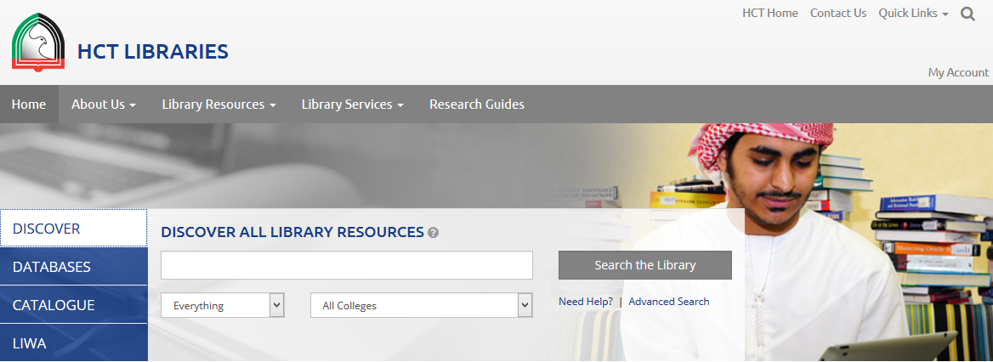
The Catalogue
Click on the DISCOVERY tab to begin searching
Notes:
Let’s look at the DISCOVER tab – this searches ALL HCT campuses for all library resources.
For students in Foundations courses, it can be recommended to start with the CATALOGUE tab instead, which searches only print and e-books, so returns a simpler (and perhaps less confusing) results list. The DISCOVER tab does bring up journal articles, newspapers etc. which are accessible through the library subscription databases, as well as print and ebooks.

Slide 31
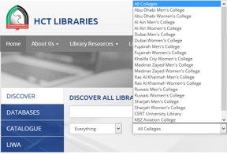
Use the “VIEW ENTIRE COLLECTION” drop-down box if you wish to select only one campus to search
Notes:
When would you (a) “View the Entire Collection” or search in only one (b) select only one campus ?
View the entire collection if
You are searching for something and don’t expect there to be many results
You can wait a few days for a book or resource to arrive from another campus
Select only one campus if
You have lots of results from your search and/or
You need the resource today and only wish to see items on the shelf which you can use now

Slide 32
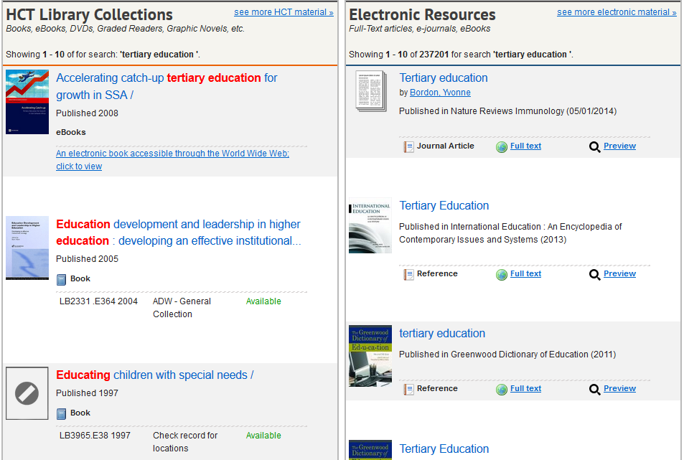
Electronic books to look at or download on your laptop
Print books available on the shelves. Location is the
“Call number”
Use the “VIEW ENTIRE COLLECTION” drop-down box if you wish to select only one campus to search
Notes:
This is how your results list will look in DISCOVER.
The left column lists print books on the shelf, and ebooks which can be downloaded to your laptop, or just read online.
The right column is a far larger result of all electronic resources in the HCT library system.
For further information about “call numbers” to locate books on the shelf, review HCT One Minute Guides: Call Numbers VIDEO
#F201, or Reading a call number (Library of Congress) VIDEO #F210
For further information about downloading and using eBooks, review HCT One Minute Guides: Download an e-book from the library catalog VIDEO #F204; or HCT One Minute Guides: Adobe Digital Editions VIDEO #F205

Slide 33
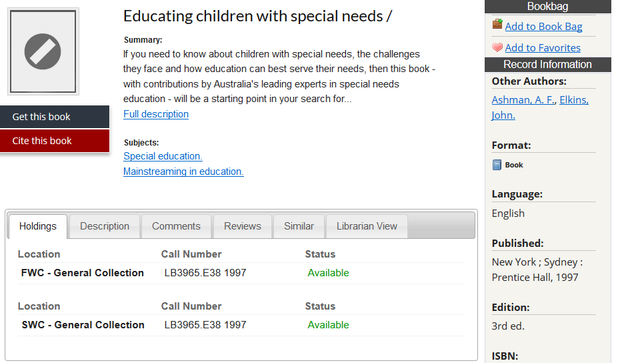
Click here to have the book sent to your location.
Notes:
Click on the title of a book in the list you would like to see, and scroll down the screen to look at the locations within HCT where this book is held. In this case, the book is in FWC (Fujairah Women’s Campus), and SWC (Sharjah Women’s Campus).
If you are in that location, the “status” shows you that the book is Available on the shelf; follow the “call number” to find it ☺
If you are in another location, simply click on the black tab on the left side “Get this book”, and complete the small pop-up screen with your user name and password. Confirm which campus you would like to pick up the book from, and you will receive an email as soon as it arrives at your location.

Slide 34
Good researchers will also click this red tab to get information about the citation for this resource (APA)
Keep your citation information together in one place ☺
Notes:
The red tab on the left side gives a pop-up box with the full citation of this book in APA and MLA styles.
Good researchers should copy, check, and keep this citation information in one place for use when completing your project, especially when you are working on a group assignment. It is often difficult to remember what resources you have found along the way if you leave it to the end!

Slide 35
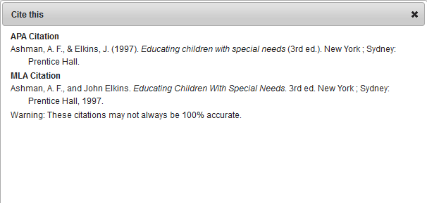
The citation pop-up screen from the DISCOVER part of the library catalog looks like this.
Copy, check, and keep your APA citations together in one place.

Slide 36
3 minute exercise
On your “Planning my Research Project” worksheet:
Search the library catalogue for books or eBooks on your topic
Write down the author and title
Write down the call number
Write down the status
(is it available today?)
Notes:
Using #T11 “Planning my Research Project” worksheet – bottom half of the worksheet.

Slide 37
3 minute exercise
On your worksheet:
“Planning my Research Project”
When you have found a book or eBook which looks useful for your assignment, click on the “Cite this book” tab to copy the APA citation:
KEEP your citations together!
Can you request a book from
another library if you want it?
Notes:
Using #T11 “Planning my Research Project” worksheet – bottom half of the worksheet.

