Slide 1
HCT: The Library Catalogue
Notes:
For this lesson, we will introduce students to The Library CATALOGUE and how to search efficiently and effectively.
See also #T13 Starting your research PPT, which includes an introduction to the research process and library resources such as the catalog, but doesn’t go into any detail about how to develop effective search strategies using the catalog.
RESOURCES:
Details on using “call numbers” in Finding Library Books on the Shelf PPT #T57 (http://blogs.hct.ac.ae/student-research/documents/t57/) and Putting Call numbers into the right order ACTIVITY #T58 (http://blogs.hct.ac.ae/student-research/documents/t58/)
For details on using eBooks, refer to Electronic Books in HCT PPT #T54 (http://blogs.hct.ac.ae/student-research/documents/t54/)

Slide 2
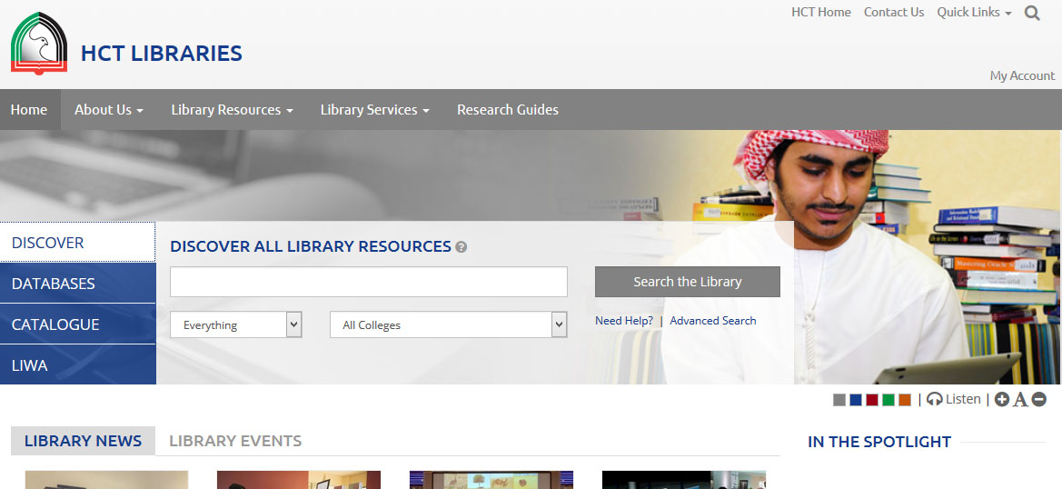
http://libraries.hct.ac.ae/
This page starts at the DISCOVER tab
Notes:
Definition of a CATALOGUE?
What can you find in a library catalogue? Books?Y Journal articles?Y Newspaper articles?Y Websites?N
Let’s discover what HCT Libraries have ☺

Slide 3
http://libraries.hct.ac.ae/
Let’s look at the different tabs..
Notes:
DISCOVERY tab will search for ALL types of library resources (books, journals, DVDs, Videos, electronic resources) in ALL HCT library campuses at once.
DATABASES are an index of the thousands of journal articles and electronic resources which are paid for by HCT, because they are excellent academic resources not available using the open Internet.
CATALOGUE searches all HCT print and electronic books
LIWA searches all of HCT, ZU and UAEU catalogues at the same time (HCT students, staff and faculty can borrow books and other resources from ZU and UAEU – ask at your library for details)

Slide 4
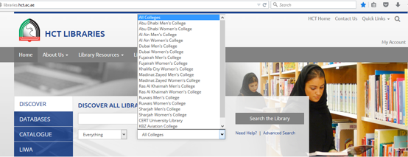
http://libraries.hct.ac.ae/
Search in either ALL COLLEGES,
or only in YOUR campus
Notes:
Use the drop-down box to select either ALL COLLEGES, or only YOUR College campus.
Which to choose?
If you need the resource today, you should look only in your campus catalogue. Electronic books (eBooks), which are available everywhere, will turn up using either search.
If you get small results, or can wait a day or two for resources to arrive from another campus, then leave this as ALL COLLEGES. It is easy to request resources from another campus – we will cover that in this session.

Slide 5
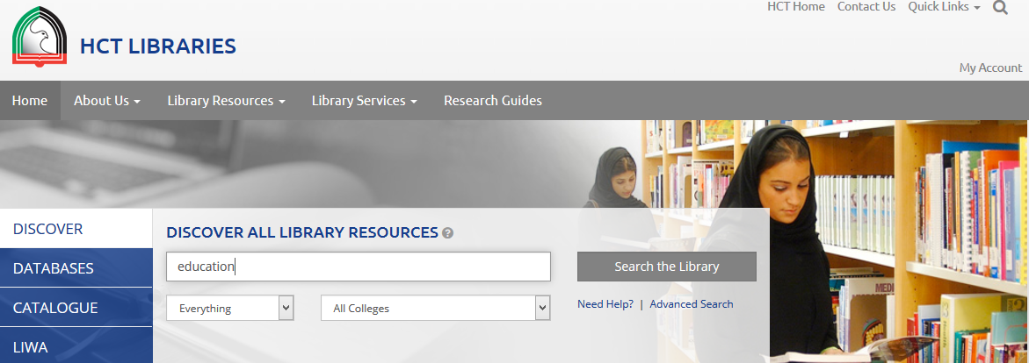
http://libraries.hct.ac.ae/
Type your search into the search box,
and SEARCH THE LIBRARY…
Notes:
There is an option to select to search for only author, title etc, if you don’t get the results you need (instead of searching for ‘everything’). Useful to use this if/when your search is not successful, or you have TOO MANY results and wish to make your results more relevant.

Slide 6
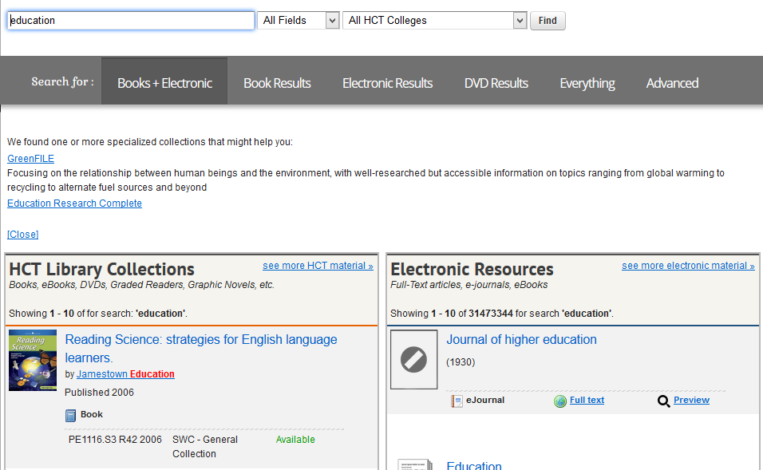
http://libraries.hct.ac.ae/
If you were after a book, click
“see more HCT material”
Notes:
This is a normal results list – print books and ebooks on the left column; all electronic resources on the right column.
Click on to “See more HCT material” to get rid of the right hand list ☺ Now you have only the list of print and ebooks.

Slide 7
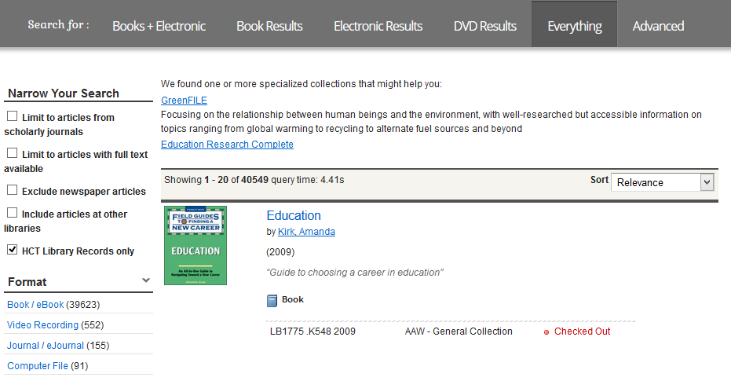
http://libraries.hct.ac.ae/
This is your list of ONLY print and eBooks when you have clicked
“see more HCT material”
Notes:
You now have the option to NARROW your search using the options on the left navigation pane, or to …
SORT the results list by relevance or date order (drop-down box on the grey bar above search results)

Slide 8
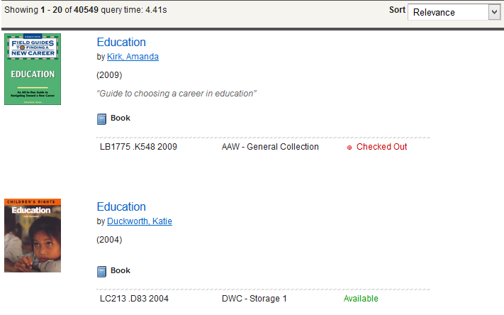
http://libraries.hct.ac.ae/
The “call number”, or shelf location
Which libraries have the title
Whether it is “available” or “checked out”
Notes:
To find PRINT books on the shelf, follow the “call number” for a location on the shelf.
Details on using “call numbers” in Finding Library Books on the Shelf PPT #T57 (http://blogs.hct.ac.ae/student-research/documents/t57/) and Putting Call numbers into the right order ACTIVITY #T58 (http://blogs.hct.ac.ae/student-research/documents/t58/)

Slide 9
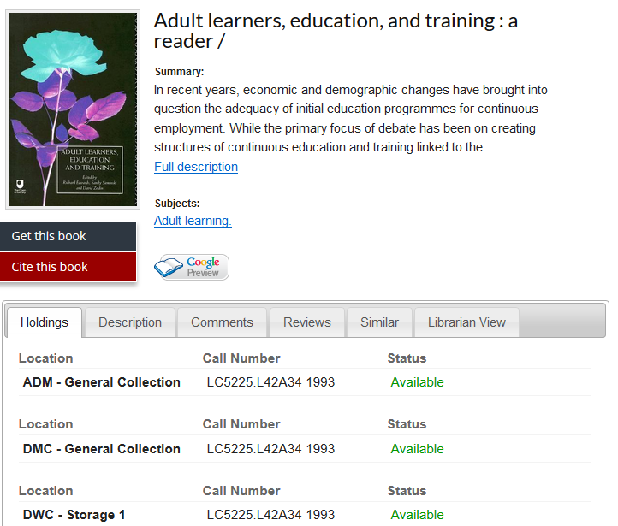
http://libraries.hct.ac.ae/
This is your list of ONLY print and eBooks when you have clicked
“see more HCT material”
Notes:
NOTE: If the information about which library has the title says “Check record for locations”, this means that more than one library holds the item – click onto the book title, and scroll to the bottom of the record to see which libraries hold the item. In this case, the list includes 3x library locations, and in each case the item is “Available” ☺
GET THIS BOOK tab (in black) allows users to request the book from another campus. It should arrive within a couple of days, and an email will be sent to tell you that the time has arrived.
CITE THIS BOOK tab (in red) will show users the full reference for this book, in APA and MLA style.

Slide 10
http://libraries.hct.ac.ae/
If your results list gives you an eBook, click onto the title or “Full text”
to see the full record.
Notes:
HCT currently subscribes to 13 Electronic Book (eBook) publishers, giving access to thousands of electronic books on and off campus. Each publisher works a little differently however, with different availability to be able to copy and paste, or to print pages.
For use on laptops, eBooks usually require the download and installation of ADOBE DIGITAL EDITIONS software to be able to download and read the eBook.
For details on using eBooks, refer to Electronic Books in HCT PPT #T54 (http://blogs.hct.ac.ae/student-research/documents/t54/)

Slide 11
http://libraries.hct.ac.ae/
If you were after an Electronic Resource, such as journal or newspaper articles,
Click “see more electronic material”
Notes:
This is a normal results list – print books and ebooks on the left column; all electronic resources on the right column.
Click on to “See more Electronic Resource material” to get rid of the left hand list ☺ Now you have only the list of journal and newspaper articles etc in electronic format.

Slide 12
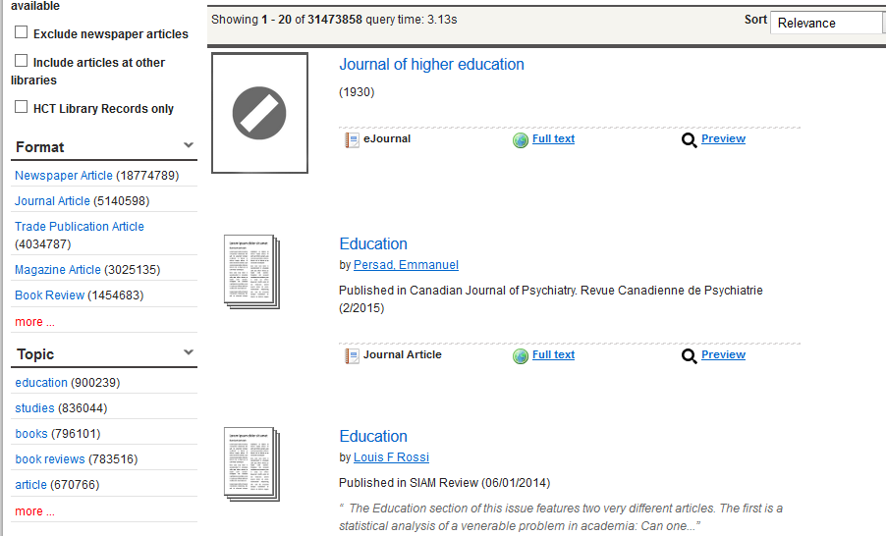
Limit your search using these options,
if that makes it a better results list
Notes:
Electronic resources were on the right column of your results list.
Click on to “See more Electronic Resource material” to get rid of the left hand list ☺ Now you have only the list of journal and newspaper articles etc in electronic format.

Slide 13
A few search tips for better results ☺
Use “” double quotation marks around multiple words to keep these words together.
Notes:
In this case all results will be about “small business” and will not include the business of small pygmies in Africa, or other options you might retrieve using these two words separately!

Slide 14
A few search tips for better results ☺
Use OR between synonyms to increase your search results, and brackets to ‘house’ these synonyms
Notes:
You are trying to find ALL of the publications about the UAE, but the author may have written “United Arab Emirates” instead of UAE, and you might miss these.
OR means MORE – you are ok to find this OR that.

Slide 15
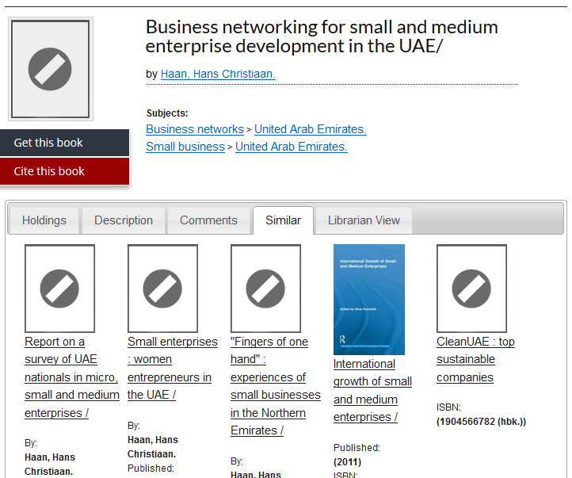
Click SUBJECT HEADINGS or SIMILAR tab for more similar results.
Use “” double quotation marks around multiple words to keep these words together.
Notes:
If you have found a resource which is good for the information you need,
click onto the SUBJECT HEADINGS to see other resources on the same topic,
or the SIMILAR tab to look at other similar recommendations.

Slide 16
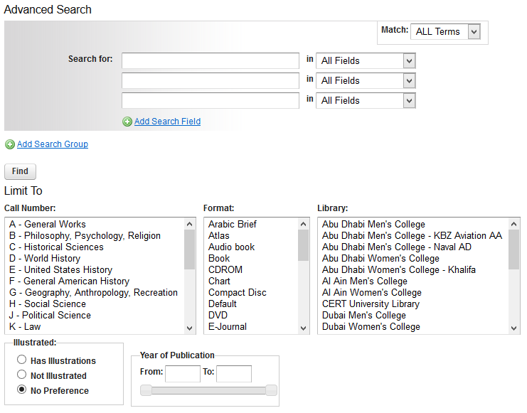
Use the Advanced Search
Use OR between synonyms to increase your search results, and brackets to house these synonyms
Notes:
“Advanced Search” option will give you lots of ways to NARROW your search, and end up with more relevant information results.

