Slide 1
Finding Library Books on the Shelf
Notes:
For this lesson, we will introduce students to Finding Library Books on the Shelf – using the catalogue to find print resources, and following the “Call Number” system to locate items in the library
RESOURCES:
Finding Library Books on the Shelves PPT (#T57 in HCT Student Research website)
VIDEO Reading a call number (Library of Congress) https://www.youtube.com/watch?v=mFzQbknKJM4 (#F210 available to students on the HCT Student Research website)
WEBLINK – Call number and shelving tutorial http://www.library.kent.edu/library-congress-tutorial-page-4-tests An interactive page with drag-and-drop tests.
Call Numbers in the Right Order ACTIVITY (#T58 in HCT Student Research website)
Optional prizes for Slide 11 activity

Slide 2
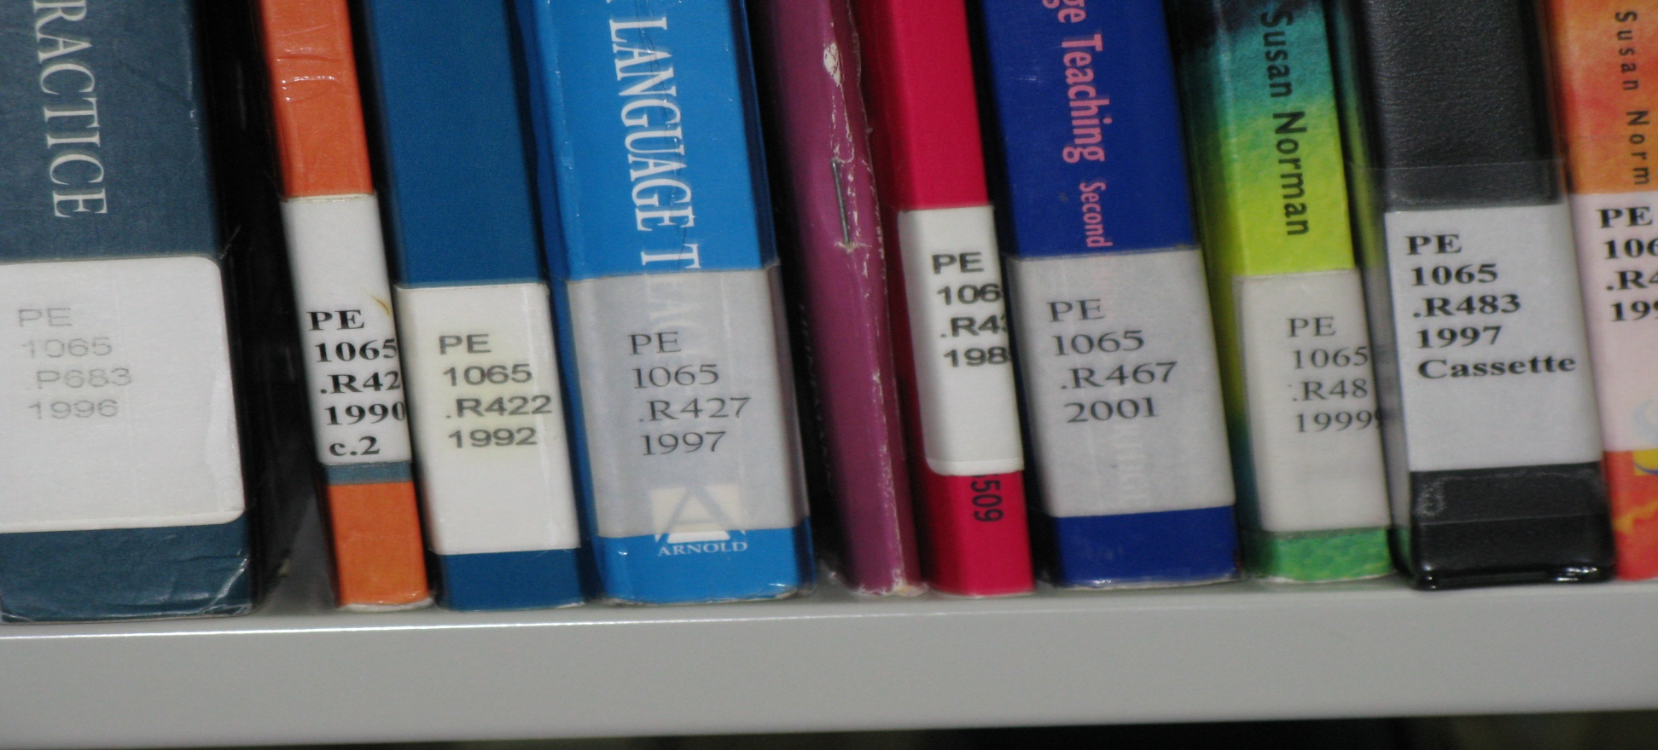
http://libraries.hct.ac.ae/
Libraries use “call numbers” to organize books and shelf resources.
Notes:
Thousands of libraries all over the world use this same system as HCT.
This is called the “Library of Congress” system, and could be different from that used by school libraries (often the “Dewey system”)

Slide 3
Call Numbers
Think of a “call number” as an address on the library shelf. How would you find that ONE item among thousands?
Just like trying to find the location of the Dubai Museum …

Slide 4
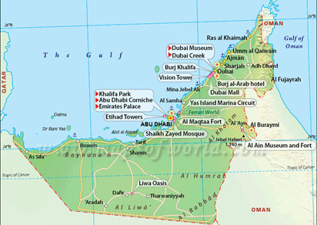
Call Numbers
You can start with a general idea …

Slide 5
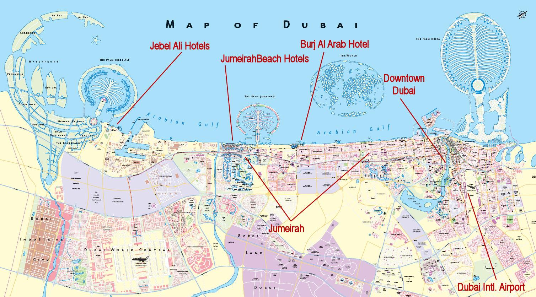
Call Numbers
Narrow your area of interest …

Slide 6
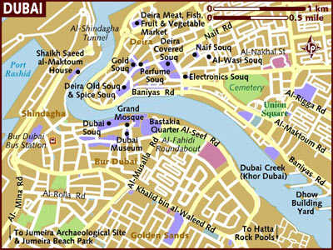
Call Numbers
Find what you’re looking for…
Notes:
Well, this would work if the UAE had addresses, but anyway…. Get the idea? ☺

Slide 7
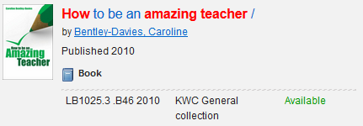
Call Numbers
When you have used the library catalogue to find a book on the shelf
… the call number looks like this.
Notes:
i.e. in a straight line.
(PPT and information about searching the HCT library catalogues to be found at #T55 in the HCT Student Research website)
NOTE Check that the book we are after is in the library you are located in, and that it’s available on the shelf.
Take a picture or write down the number. This is our address to follow ☺

Slide 8
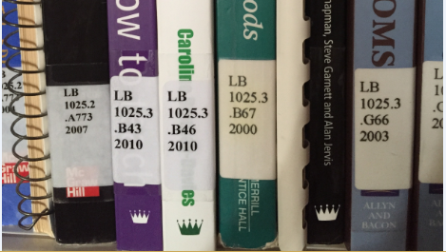
Call Numbers
When you go to the shelves, the call number will look like this…
… the call number looks like this.
Notes:
i.e. on a book spine in different lines
So what do these numbers and letters all mean?

Slide 9
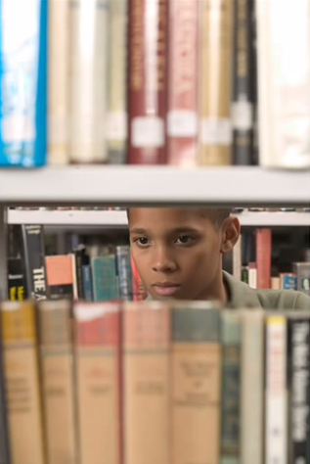
Call Numbers
Watch this short VIDEO to see what
call numbers mean:
Reading a Call Number
Notes:
Click on the image – hyperlinked to the YouTube video
Reading a call number (Library of Congress) https://www.youtube.com/watch?v=mFzQbknKJM4
An easy basic introduction to what call numbers mean, and how to use them to find resources on the library shelves. Useful 1-1:46 mins.
Produced by Douglas College Libraries, US. Video is 2:07 min. (Resource #F210 available to students on the HCT Student Research website)

Slide 10
Call Numbers
Notes:
So in summary, these are the main areas for “call numbers” used at HCT (Library of Congress system), and what they mean.

Slide 11
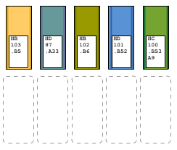
Call Numbers
Testing, testing.
Now go to Kent State University website to try these fun
drag-and-drop
tests
http://www.library.kent.edu/library-congress-tutorial-page-4-tests
Notes:
Click on the image – hyperlinked to the Internet
Call number and shelving tutorial http://www.library.kent.edu/library-congress-tutorial-page-4-tests
This is an excellent interactive page where student drag-and-drop “books” into the right order. The page will ask to check, and then tell you “correct”, or try again ☺
Some are quite difficult!
How many can students get correct?

Slide 12
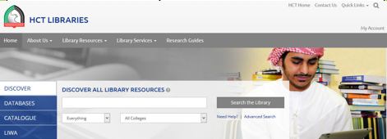
Call Numbers
Time to search the library catalogue, and find what you need on the shelves
Library staff are always there to help ☺
Notes:
If students are still having problems, or as an alternative short activity, try #T58 Call Numbers in the Right Order ACTIVITY from HCT Student Research website.
This activity is mobile and quick, as students are asked to get themselves into call number order at the front of the class, as if they were books on the shelf.
NOTE Reminder that when students go to the shelf, the library tries to keep other books on the same topic in the same place (the call number first places all books together on the same subject), so browse the shelves nearby for other similar resources ☺

