Slide 1
Evaluating Information Resources
Notes:
Evaluating Information Resources #T103 on the HCT Student Research website – will introduce students to the need for knowing what type of information is available to them, and whether the resource they have found is likely to be useful for academic research.
RESOURCES
For WEB evaluation:
Credible Sources Count Tutorial (usefully used individually) 10 min. tutorial. Resource #E52 in the HCT Student Research website.
Evaluating Websites (usefully used either individually or as a group) 2 min. video from YouTube. Resource #E53 in the HCT Student Research website.
REVIEW the Publishing Cycle if needed (#U100 “The Information Cycle” or #101 “The Information Life Cycle” YouTube videos)
#T104 Reviewing Google Results WORKSHEET from the HCT Student Research website
#T102 Evaluating Websites WORKSHEET from the HCT Student Research website
For BOOK and JOURNAL evaluation:
Collect enough books and copies of an academic journal to give one each to pairs or small groups in your class.
#T105 Evaluating Print Sources WORKSHEET
NOTE
For information about Successful Web Searches see resource #T56 Successful Web Searches PPT

Slide 2
So, you need good academic information for your assignment?
Notes:
Where to start ☺

Slide 3
If you type your keywords into Google, you’ll get millions of hits! That’s enough isn’t it?
Notes:
Is millions of hits useful? No … (Refer to #T56 for a detailed session on improving your search results in Google)

Slide 4
Not enough for success in higher education!
Your research work needs to include different information resources, like
books
newspapers
journal articles
web resources
Notes:
What is asked for in the current assignments of students?
WHY should you be looking at different sources of information?
(not every source has the most reliable information/ you may need to find different pieces of information from different places/ you may need to give different sides of an argument in your research/ you should check that the information you have found is supported in other places/ you may need both recent and more historical information)

Slide 5
The publishing cycle
Different types of information are published at different times – what do you need?
Also important to understand that different information resources have different
editorial control.
This affects the reliability of the information.
Notes:
REVIEW the Publishing Cycle (#U100 “The Information Cycle” or #U101 “The Information Life Cycle” YouTube videos for review if needed)
The longer it takes to publish (usually) the more input from other experts in the field to ensure the quality of the information.
FOR EXAMPLE
Information available immediately on the Web or Social Media may have little other than personal opinion (some Web information is not available immediately because it is also edited and good quality information)
Newspapers and magazines usually have an editor who checks the reliability of the information, but often not experts
Scholarly journals take months to publish because articles are reviewed by other experts in the field, and all information is checked
Books and Reference sources involve large editorial groups of experts, and the reputation of large publishers is important to maintain (there are also scam book publishers too, so beware!)

Slide 6
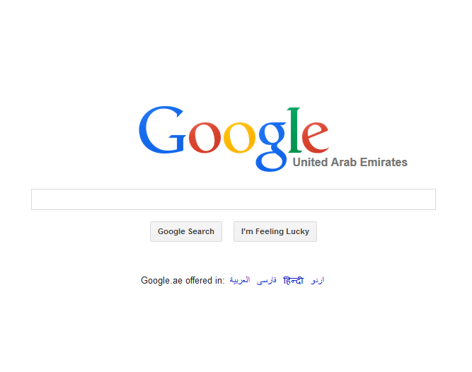
Notes:
Let’s start by looking at some quick ways to evaluate WEB information.
Who can publish on the Internet? (anyone)
What types of resources could you find on the Internet? (blogsites/ images/ government sites/ information sites/ malicious information/ things for sale……)
The trick is to be able to decide how reliable the information you are looking at is. Know what you are looking at!
Information available immediately on the Web or Social Media may have little other than personal opinion
Web information is sometimes not available immediately because it is edited and good quality information involving experts
Malicious/ commercial/ biased and misleading information is also available on the Web
… what should be included in your academic research?
… how to decide this without taking weeks of effort??

Slide 7
Domain Names (URL)
What does this website URL tell you?
http://www.hct.ac.ae/
http://www.hct.ac.ae/ Name of the organization
http://www.hct.ac.ae/ Type of organization
http://www.hct.ac.ae/ Country of website
Notes:
What’s in a name? A lot when it comes to websites! ☺

Slide 8
How many of these do you know?
.uk
.om
.au
.ca
What does the USA use?
Notes:
UK
Oman
Australia
Canada
Nothing – they invented the Internet, so if it has no country code, it’s probably from the US ☺
So, by looking at the URL you can usually know where the information originated.

Slide 9
Domain Names (URL)
.com Commercial (or blogsite)
.co Commercial
.org Organization
.gov Government
.edu Education
.ac Academic education
.net Network
Notes:
More importantly, this part of the URL (probably) tells you what type of organization has created this information.
(This information could be brainstormed from students instead of presented)
Commercial – to sell something. Likely to have a biased viewpoint.
Organizations – can be anyone at all, but if you recognize the name of the organization (like UNESCO or World Bank) there is likely to be good quality information.
Government – likely to be reliable, but is it “the truth”?? Different governments are likely to publish different viewpoints on some issues, yes? Iran and the USA may have different viewpoints, or Russia and the Ukraine may have different viewpoints – all could be on a government website, so THINK about the issue you are researching ☺ Government sites usually excellent for health topics.
Education – published by schools or universities so usually reliable academic information. If the ~ is used after the main URL (e.g. hct.ac.ae/~Smith/publications) then the information is from an individual within that educational organization, so be a little more careful
Academic education – usually only higher education. Ditto Education above
Network – usually a hub or Internet provider (such as Etisalat)
Blogsite – what is a blogsite? Usually uncontrolled and unedited information, but if you follow an author/ academic/ researcher etc it could be excellent information
In all cases, by understanding the URL and what it can tell you, you will better know what you are looking at. The Website could be biased, but now you know a little about who the author/publisher is, and perhaps it is good to collect different viewpoints for your assignments.

Slide 10
You are researching: health effects of smoking
http://heartland.org/ideas/smokers-rights
http://www.cdc.gov/effects_cig_smoking
http://www.health.harvard.edu/smoking
http://www.nhs.uk/smoking-risks
http://www.nhlbi.nih.gov/health/risks
Which would you look at first?
Notes:
TESTING
The goal is to make your review of a Google results list shorter and more productive ☺
cdc.gov
health.harvard.edu
nhs.uk – if you recognize the organization
nhlbi.nih.gov

Slide 11
You are researching: benefits and problems with diet drinks
http://www.nextavenue.org/blog/diet-soda
http://nepc.colorado.edu/files/lancet.pdf
https://www.womentowomen.com/healthy-weight/diet-soda/
Which would you look at first?
Notes:
TESTING
The goal is to make your review of a Google results list shorter and more productive ☺
nepc.Colorado.edu
Could discuss the relative merits of the other websites – not necessarily bad information. Just know the source of the information you are looking at to understand bias/ objectivity/ likely expert input/ reputation of the organization etc

Slide 12
Notes:
ACTIVITY: In pairs or small groups students go into Google.ae and answer the simple worksheet from the FIRST PAGE of results in Google
#T104 Reviewing Google Results WORKSHEET from the HCT Student Research website

Slide 13
Notes:
Once you have found useful looking websites, a better level of evaluation is now needed.
Class view the YouTube VIDEO Evaluating Websites (Resource #E53 in the HCT Student Research website.) NOTE this video is hyperlinked to the slide image.
Alternatively, before/ during or after class, students could view the very good 10 min. tutorial titled Credible Sources Count (Resource #E52 in the HCT Student Research website)
ACTIVITY: Students complete #T102 Evaluating Websites WORKSHEET, and report back to the class.
And then students find 2x websites related to their assignment which they can show is likely to have reliable academic information. Justify selections!

Slide 14
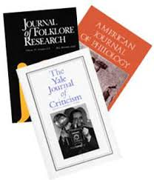
What about evaluation of print information sources?
… and journals
Like books
Notes:
This is usually a lot easier ☺

Slide 15
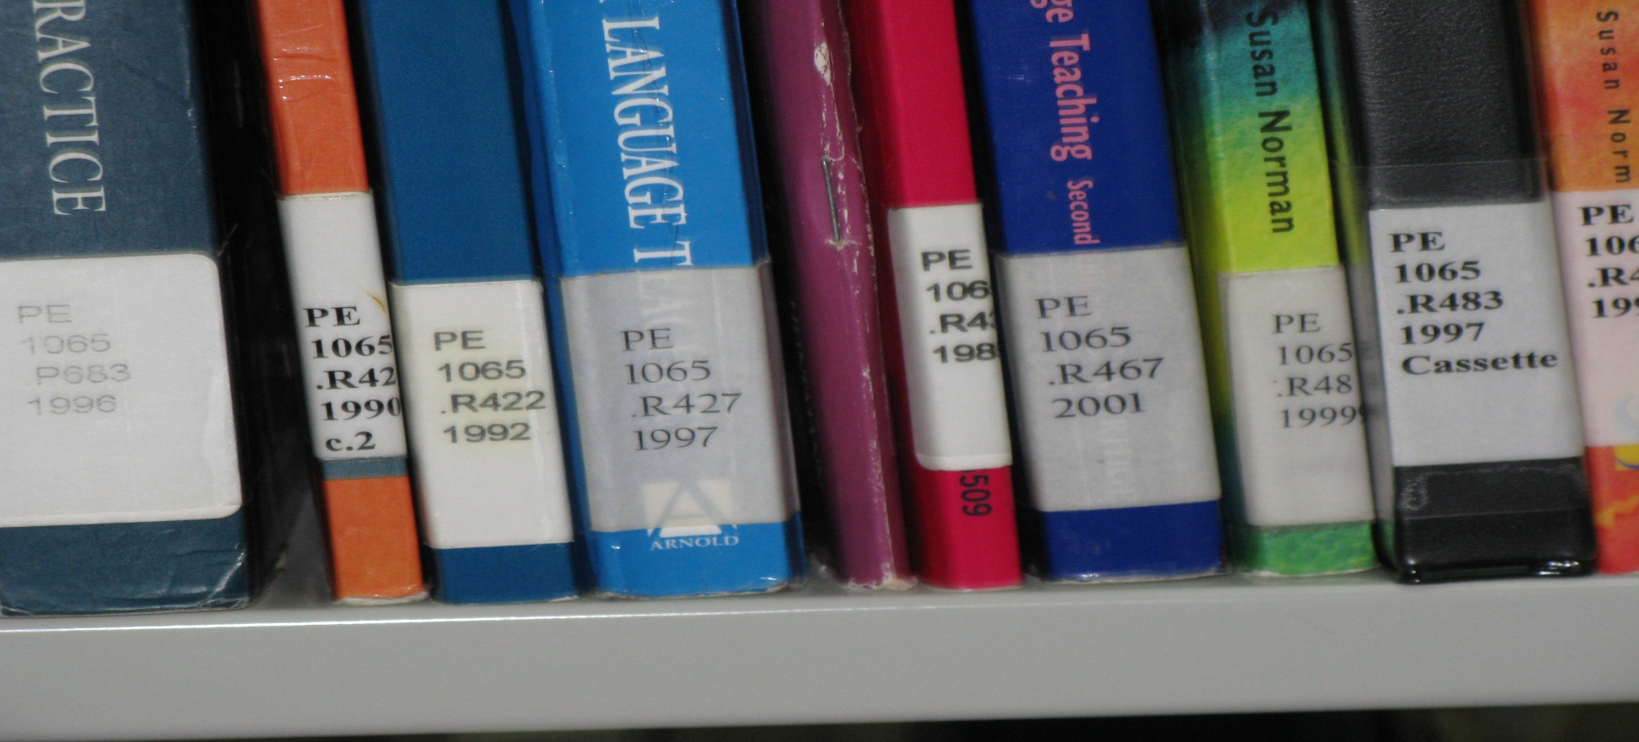
Most of the print resources you use will be from the library ☺
Notes:
This means that librarians and faculty have already evaluated most of these resources, and have tried to select reputable publishers and authors.

Slide 16
Evaluating print resources
Look for information in the book or journal:
Author information is usually on the back of a book, on the jacket cover, or near the contents page.
The Foreword of a book often includes reference to the status or accomplishments of the authors
The journal cover, or start of a journal article usually contains author information
Online information can be found in Google, GoogleScholar, and WorldCat.
Notes:
As students may not always have the benefit of the HCT library to select resources for them, it is useful to understand what they could look for, and where that information may be found.
ACTIVITY: Students choose one book and one journal from a pile supplied at the front of the classroom, and complete WORKSHEET:
#T105 Evaluating Print Sources WORKSHEET

Slide 17
Not all information is useful for academic research projects. Which of the following criteria are important to consider when evaluating information?
information is current
information is interesting
information is reliable
information is authoritative
Notes:
TESTING ☺

