Slide 1
The Research Process Teacher Introduction
Big6

Slide 2
What is it?

Slide 3
What is it?
The Big6 is a research methodology or model that …
…provides a structure for doing research
…by breaking down any information need into 6 discrete steps

Slide 4
1. Task Definition
2. Information Seeking Strategies
3. Location and access
4. Use of Information
5. Synthesis
6. Evaluation

Slide 5
Students and Research

Slide 6
Why do we need a research model to begin with?

Slide 7
Why do we need a research model to begin with?
HCT Learning Model comprises 8 Graduate Outcomes

Slide 8
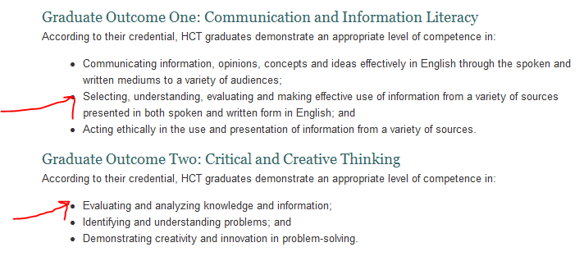

Slide 9
Why have a research model?
To give structure to the teaching and learning of effective research.
To map the proper sequence of actions that are required to undertake research.
To make explicit and delineate the emotional journey that students go through when doing research
Protect sustainability of research teaching from faculty/librarian turnover

Slide 10
Why use the Big6

Slide 11
Why use the Big6?
Good model – doesn’t leave anything out
Easy to understand and remember
Comes with a supply of free and published classroom ready materials
Big6 is a “ready to implement program”
Big6 is widely used and uses a language more accessible for our students.

Slide 12
Big6 steps
SIX steps to teach you to follow a process when you do research. Teach steps to start, do and finish a project/task in an organized way.
1. Task Definition
2. Information Seeking strategies
3. Location and Access
4. Use of information
5. Synthesis
6. Evaluation

Slide 14
Step 2: Information Seeking Strategies
Tasks
2.1 Determine all possible sources
2.2 Select the best sources
Where can you start to look for information?
Who can I talk to to get information?
What are the best sources to use?
Anxiety & Excitement

Slide 15
Step 3: Location and Access
Confusion & Doubt
Tasks 3.1 Locate sources 3.2 Find information within sources
What types of resources can I find?
Where can I find these resources?
Where and how do I find the information in the resources?

Slide 16
Step 4: Use of Information
Tasks 4.1 Engage (e.g., read, hear, view, touch) 4.2 Extract relevant information
What type of information did I find?
Will the information answer the questions I have?
How do I write notes of the information to understand it?
Optimism & Belief in Abilities

Slide 17
Steps 5: Synthesis
Confidence & Increased interest
Tasks 5.1 Organize from multiple sources 5.2 Present the information
How do I write an outline of the project?
How do I present the information to my teacher to answer the question?
Did I remember to make notes of all the sources in the bibliography?

Slide 18
Steps 6: Evaluation
Relief or Disappointment
Tasks 6.1 Judge the product 6.2 Judge the process
Did I solve the problem?
Is it written for my audience?
What did I learn?
Am I pleased with my project?

Slide 20
Summary of the scope of Big6
Apply the Big6 skills - plan, do and review a project
Learn how to break a project down into tasks
Identify type of questions to be asked to understand your focus area
Understand the emotions and feelings you will experience during each step

Slide 21
Recap
Big6 is a guide on where to start and what to do! Generic process.
Logical pattern Imitates what we do in real life
Repetition is best. Opportunities to practice all around
Emphasized by all teachers

Slide 22
Incorporating the Big6

Slide 23
Incorporating the Big6
Ensure students understand the emotional journey of research and that by breaking down the process into discrete stages it will make the process far simpler.

Slide 24
Incorporating the Big6
Learn the Big6 steps and incorporate into your lessons and discussion on research.
Take advantage of the libraries’ information literacy classes on offer and request a tailor-made class to suit your class.
Consult a librarian on curriculum and assignment design to map specific skills to an assignment.
For students to search for information well, refer to the sections on Finding and Evaluating information in the
“HCT Student Research” website
Consider faculty/ librarian partnerships to assist with assessing the research component of any given assignment.
Get students to keep a research journal for every assignment based on the Big6 stages.

Slide 25
Big6 Resources
Direct students to our HCT created interactive tutorial about the Big6:
iFooz
http://dwc.hct.ac.ae/lrc/ifooz/artwork/
(resource #U200 in the “HCT Student Research” website)

Slide 26
Resources in the Faculty Collection on the Big6
Books with assignments, exercises, rubrics, worksheets, lesson plans, IDEAS
Posters
Visual Aids
DVDs

