Slide 1
APA Referencing
In-text and Reference Lists
Notes:
#T154 APA Referencing covers an introduction to citations and referencing, and how these can help to avoid plagiarism briefly. Discussion of how to create citations using a variety of tools, and all about in-text citations.
For a detailed lesson on Plagiarism refer to #T150 Plagiarism at HCT PPT.
Referencing and citing information in-text is a large topic which benefits greatly from repeated practical application. This PPT therefore includes a large range of videos and online tutorials to watch, as well as worksheets and activities to undertake. It is recommended that some of these resources are undertaken in-class and some out of class – homework assignments could form part of the subject assessment; the lesson time would be recommended to be split over more than one session.
RESOURCES
#S16 Why you need to Cite Sources https://www.youtube.com/watch?v=5UcCBByLchw A simple and clear introduction to why you need to cite the sources you use in your research. Produced by the College of San Mateo, US. Video is 2.09 min.
#T155 activity sheet: Glossary for Citations and Referencing ACTIVITY A brief glossary and activity sheet useful for students. Use in conjunction with #S16 VIDEO – “Why you need to Cite Sources”.
#S11: What is a citation? http://www.educanon.com/public/106211/248212?cn=s A short video clip showing what type of things can have a citation, and what citations look like. Quiz included. Video clip is 0:40 secs. Produced by University of South Florida and EduCanon.
ACTIVITY: To cite or not to cite? #T156, #T157, #T158
Three separate (similar) worksheets are available so that fewer questions are asked of each group – in pairs or small groups students complete their worksheet, and then report back to the class. Students need to have decided when a citation is appropriate, and when it is not needed.
#S10 APA Referencing HANDOUT – Provide copies for all students in the class, or link to the HCT Student Research website, or link through Bb Learn
Reference on slides 10-14 pointing to HANDOUTS for assistance with different tools to create citations with, and different formats which might need different citation information (such as artworks, personal correspondence etc.)
In text Citations
WATCH: APA in Minutes: In-text citations https://www.youtube.com/watch?v=qzKlb7E7ERc #S50 An excellent, clear guide to what an APA in-text citation is and how to use them in your work. Produced by Humber Libraries, US. Video is 2:35 min.
WORKSHEET: When to Cite in-text #T152 (and answer key #T153)
HANDOUT In-text citations APA style #S51 A brief handout giving examples of how to add in-text citations into your writing.
WEBSITE In-text citations: The basics https://owl.english.purdue.edu/owl/resource/560/02/ #S52 Purdue University in the USA has a very good reputation for creating easy to use but accurate guides to APA style (and writing assistance in general).

Slide 2
What is plagiarism?
Plagiarism is when you use another’s thoughts, words, or ideas and you present them as your own.
Notes:
Introduce the concept of Plagiarism. How many students in the class have heard the term?

Slide 3
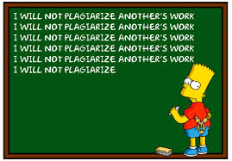
Notes:
Why is Bart doing detention for Plagiarism here? Is this the worst that can happen if you are caught Plagiarizing?

Slide 4
What happens to those who plagiarize?
Kicked out of school
Fired from job
All prior work suspect
Poor reputation
Notes:
Here we can see some of the consequences for plagiarizing.

Slide 5
How can we make sure we don’t plagiarize?
Use APA Referencing!
Notes:
HCT recommends APA referencing but always check with your teacher. Some programs require specific referencing styles.
WATCH the following short VIDEO: #S16 Why you need to Cite Sources https://www.youtube.com/watch?v=5UcCBByLchw A simple and clear introduction to why you need to cite the sources you use in your research. Produced by the College of San Mateo, US. Video is 2.09 min.
THEN use #T155 activity sheet: Glossary for Citations and Referencing ACTIVITY A brief glossary and activity sheet useful for students. Use in conjunction with #S16 VIDEO – “Why you need to Cite Sources”. Short practical exercise then to identify some of the common words useful to recognize when referencing, and to test understanding.

Slide 6
Why reference?
To help others find the sources you used.
Give credit to those who did the original work or research.
To help the reader find the original source in order to read more or verify information.
In-text referencing helps the reader to find full details of sources in the reference list and shows which ideas belong to whom.
Universal – regardless of language.
Notes:
Here are the reasons we reference or cite.
… and what does a reference, or a citation look like?
View the short VIDEO #S11: What is a citation? http://www.educanon.com/public/106211/248212?cn=s A short video clip showing what type of things can have a citation, and what citations look like. Quiz included. Video clip is 0:40 secs. Produced by University of South Florida and EduCanon.

Slide 7
What are citation STYLES?
Look at the following references:
Steinbeck, J. (1952). East of Eden. New York: Viking.
Steinbeck, John. East of Eden. New York: Viking, 1952.
Same book, but the way of writing the reference changes with the style. Which as APA/MLA?
Notes:
APA is the HCT preferred style (the first reference) An easy way to pick APA is that the date of publication is always just after the author in brackets.
There are actually thousands of citation styles – the main ones are APA, MLA and Chicago.
The main idea is that whichever style you use for citing your sources, you follow that style, and you are consistent!

Slide 8
Example of a Reference List
Backer, H. D. (2008). Wilderness first aid:
emergency care for remote locations, third edition.
Sudbury, Massachusetts: Jones And Bartlett
Publisher.
Chamberlain, J. M., Krug, S., & Shaw, K.
(2013). Emergency care for children in the United
States. Health Affairs, 32(12), 2109-2115.
Notes:
What does the Reference list look like (at the end of your paper)? Also known as the Bibliography.
This bibliography is using APA style. How many styles are there – can anyone remember any others?
Features of a bibliography:
References/ bibliography starts on a new page, and simple heading
Alphabetical by author (or title if no author)
Indented after the first line of each entry
APA only does the Uppercase Letter for the first letter of the Title of the book or article.
Format of each citation is very regular – different format for each type of resource e.g. a book, a journal article, an artwork
More than one author is separated by & - if three or more authors, it would be Smith, A., Jones, G. & Martin, K.
SO…
You need to cite all of your resources in an academic paper – different from school now!
Citations have a regular pattern (a citation style) – needs to be followed carefully.
When you write a paper, you will have:
in-text citations within the body of your paper, and
A reference list at the end
Students could review the reference lists located at the back of books or academic journal articles to verify these standards.

Slide 9
When to reference?
When you use someone else’s idea.
When you use someone else’s words either exactly as they are, or changing them into your own words (paraphrasing).
When not to reference?
Common / General Knowledge
Call 999 in an emergency.
The sun is yellow.
The sky is blue.
Notes:
ACTIVITY: To cite or not to cite? #T156, #T157, #T158
Three separate (similar) worksheets are available so that fewer questions are asked of each group – in pairs or small groups students complete their worksheet, and then report back to the class. Students need to have decided when a citation is appropriate, and when it is not needed.

Slide 10
How to reference?
There are many easy ways to learn how to reference your information sources
Use a master sheet or website giving examples to follow (HANDOUT of basic APA examples for HCT)
Use the “References” tab in MSWord
References tab
Notes:
#S10 APA Referencing HANDOUT: If you have a resource you need to reference, check this handout for the APA style you will need for many basic resource formats, such as books, journals, newspapers etc. This handout is developed by and relevant to the type of resources to be referenced by HCT undergraduate students.
MSWord has a simple but effective Referencing tab – see resource #S30 for more information about using MSWord referencing

Slide 11
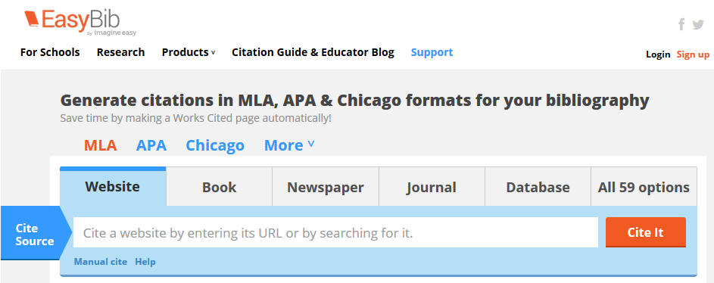
How to reference?
Use one of the many free online citation tools. You can type in the information you have, or sometimes upload the whole reference.
Try http://www.easybib.com/
Notes:
Free online citation tools include http://www.bibme.org/ or http://www.easybib.com/ - see #S34 for more information about using EasyBib for referencing

Slide 12
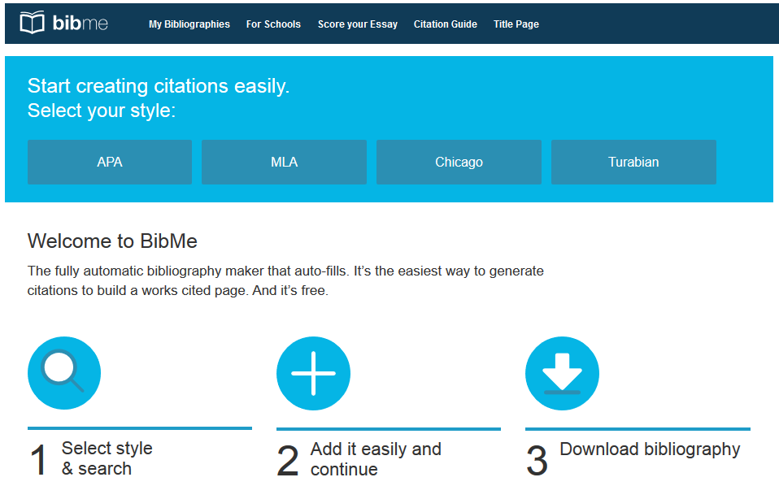
How to reference?
Use one of the many free online citation tools. You can type in the information you have, or sometimes upload the whole reference.
… or try http://www.bibme.org/
Notes:
Free online citation tools include http://www.bibme.org/ or http://www.easybib.com/ - see #S33 for more information about using BibMe for referencing

Slide 13
How to reference?
Use the HCT database NoodleTools
Good graphics to identify what information you might need, and where it might be on that resource.
Notes:
A HCT Database subscription
http://libraries.hct.ac.ae/ - Databases – Citation Tools – NOODLETOOLS
NoodleTools is very good for assisting students to identify what type of information source they have, and therefore which pieces of information they will need for that type of reference (e.g. what is a journal article, or where to find the information you will need from a website)
An excellent STUDENT research project assister
Styles: APA/ MLA/ Chicago only
Formats: 6 basic resource formats
Must start a PROJECT before you can enter citations or anything else.
Can copy and paste an existing citation, or fill out fields for that resource format.
NoodleTools is a complete assignment/project organizer for students, including a reference generator – see resources #S31 and #S32 for more information about using NoodleTools

Slide 14
How to reference?
Learn how to download references from the library catalog or databases, WorldCat, or Google Scholar
HANDOUTS are available to find out how to download references from all of these resources.
Always check that the download is correct!
Notes:
HANDOUTS available for downloading references for the library catalog #S40; library databases #S41; WorldCat #S42; Google Scholar #S43 for more information about using these tools for referencing
HANDOUTS - There are sometimes different requirements for the referencing of different types of resources. Refer students to the range of handouts available on the HCT Student Research website: #S20 Images; #S21 and #S22 Websites; #S23 Personal Communications; #S24 Artworks

Slide 15
In-text APA
citations
Notes:
What does “in-text” mean? How does it work…
WATCH: APA in Minutes: In-text citations https://www.youtube.com/watch?v=qzKlb7E7ERc #S50 An excellent, clear guide to what an APA in-text citation is and how to use them in your work. Produced by Humber Libraries, US. Video is 2:35 min.
Then students attempt this worksheet:
WORKSHEET: When to Cite in-text #T152 (and #T153 is answer key)
Time in or out of class? Review the following resources:
HANDOUT In-text citations APA style #S51 A brief handout giving examples of how to add in-text citations into your writing.
WEBSITE In-text citations: The basics https://owl.english.purdue.edu/owl/resource/560/02/ #S52 Purdue University in the USA has a very good reputation for creating easy to use but accurate guides to APA style (and writing assistance in general).
WORKSHEETS NEEDED on how to find the information needed to complete a reference in a book, website, newspaper etc., and using in-text citations

Slide 16
In-text citations
According to Smith (1999), “there is a dark and tragic Tasmania of brooding mountains” (p. 330).
It has been claimed that students love to use new technologies (Jones, 2012), but some students are not so keen!
Jones (2012) discussed the importance of this issue, and concluded that …
(FULL reference is then at the end of the paper)
Notes:
So what do in-text citations look like?
Citing your references in the body of your text points the reader to where to find the main information at the end Reference list or Bibliography.
In-text citations can be a direct quote, e.g. Smith, or a paraphrase, e.g. Jones
(ask students – what is paraphrasing?)
This is what your assignment looks like as you refer to information and arguments you have found.
The full reference, such as …
Smith, J. (1999) The history of Tasmania. Sydney: Longman.
…. would then be in the reference list at the end of your assignment.

Slide 17
Citing a Long Quotation
Example:
Smith (1999) also stated the following:
Tales of rainy coasts, forbidding mountains, and
savages on the beach did nothing to kindle any
enthusiasm for the place among his masters and
when his subsequent voyage in 1644 turned up
pretty much the same things, the Dutch gave up
on Australia altogether. (p.330)
Notes:
Go into detail about long in-text citations over 40 words. Could be too much detail – depends on the stage of the students. Can hide this slide for introductory sessions.
Indented. No quotation marks.

Slide 18
Quiz Time!

Slide 19
Question 1 – True or false?
You only need to reference if you quote someone’s exact words.

Slide 20
Question 2 – True or false?
If you copy and paste a text but change the words, you don't need to reference.

Slide 21
Question 3 – True or false?
You don’t need
in-text referencing if you have a reference list at the end.

